Slide 1
An Overview of Financial Management

Slide 2
Why Understand finance ?
Help understand financial Jargon.
Unavoidable part of everyone’s lives ( Individuals, Sales people, Business owners)
Reading financial Statements (perfect for aspirant billionaire investors)
Appreciating the Time Value of Money
Better profit Planning and Control
Managing Cash flows

Slide 3
CONCEPT OF FINANCIAL MANAGEMENT
What is Finance
SUB-SET OF ECONOMICS AND IN ESSENCE IS ALSO TERMED AS APPLIED MICRO-ECONOMICS.
IMPORTANT BUSINESS ACTIVITY.
FUND MANAGEMENT SCIENCE.
FOCUSES ON WEALTH MAXIMIZATION GOAL/ENHANCING FIRM’S VALUE.
FOCUSES ON FUTURE DECISION BASED ON ACCOUNTING FINANCIAL STATEMENTS.
ALSO REFERRED AS CORPORATE FINANCE OR MANAGERIAL FINANCE.

Slide 4
SUB-SET OF ECONOMICS
The fundamental Approach says
Defines the environment in which the firm operates i.e. key Macroeconomic factors such as:-
Growth Rate of Economy,
Domestic savings.
Tax Environment.
Inflation rate.
Real interest rate.
ECONOMY
INDUSTRY
BUSINESS FINANCE
Finance in essence, is applied Micro-Economics
key Microeconomic tools
principal of marginal analysis according to which a decision should be guided by a comparison of incremental Benefits and Cost
COMPANY
Economics Focuses on optimization of Valued Goals.
Finance Focuses on Wealth Maximization (vs. Profit Maximization)
To Sum up, a basic knowledge of macro-economics is necessary for understanding the environment in which company/firm operates.
Good grasp of micro-economic principles is helpful in sharpening the tools of financial decision making

Slide 5
IMPORTANT BUSINESS ACTIVITIES
Major Business Activities in a Firm is categorized as:-
PRODUCTION
MARKETING
FINANCE

Slide 6
FUND MANAGEMENT SCIENCE
CHOICE OF FINANCIAL MARKET
CHOICE OF FINANCIAL INSTRUMENT---FINANCING DECISION
OPTIMUM CAPITAL STRUCTURE DECISION
OPTIMIZATION OF COST OF CAPITAL
Financial Market
Investors
Shareholders
Lenders
Investors provide the initial cash required to finance the business proposal
The Business
Proposal
The proposal generates cash to investors

Slide 7
FUND MANAGEMENT SCIENCE
FINANCE FUNCTION
FINANCING INVESTMENT LIQUIDITY
DECISION DECISION DECISION
Investment or Long Term Asset Mix Decision
Financing or Capital Mix Decision
Dividend or Profit Allocation Decision
Liquidity or Short Term Asset Mix Decision

Slide 8
FOCUSES ON WEALTH MAXIMIZATION GOAL/ENHANCING FIRM’S VALUE -The process of value creation
  Economic conditions
Political and
social
environments
VALUE
SALES
EBIT
EAT
EPS
  Market
  structure
Firm’s
competitive
position
CREATION
Economic Risk + Operational Risk + Financial Risk
Business Risk

Slide 9
RISK-RETURN PARADOX
PROFITABILITY
Maximize sales
Maximize Market Share
Minimize Cost
Capital Budgeting Decision
Capital Structure Decision
Dividend Decision
Working Capital Management
Risk Management
Survive
Avoid financial distress and bankruptcy
Beat the competition
Maximize sales or market share
Minimize Costs
Maximize profits
Maintain steady earnings growth
Contradictory*
MINIMIZING RISK
Bankruptcy avoidance
Stability
Safety
*Pursuit of profit involves risk; it is not possible to maximize both safety and profit:- Need of goal that encompasses both factors
RISK AND RETURN TRADE OFF
WEALTH MAXIMIZATION/ENHANCING VALUE OF THE FIRM (EVA)

Slide 10
FOCUSES ON FUTURE DECISION BASED ON ACCOUNTING FINANCIAL STATEMENTS
Share Capital
  Equity
  Preference
  Reserve &Surplus
  Secured Loans
    Debentures
    Loans and advances
    Unsecured Loans
    Current Liabilities and Provisions
    Trade Creditors
    Provisions
Fixed Assets (net)
  Gross block
  Less: depreciation
  Investments
  Current Assets, loans and advances
    Cash and bank
    Receivables
    Inventories
    Miscellaneous expenditure and losses
Capital structure and Cost of Capital [WACC]
Working Capital financing policy
Capital Budgeting
Portfolio Management
Cash Management
Credit Management
Inventory Management

Slide 11
ALSO REFERRED AS CORPORATE FINANCE OR MANAGERIAL FINANCE
The Role of The Financial Manager
The Balance-Sheet Model of the Firm-Traditional Approach
The Net Working Capital Investment Decisions
Current Liabilities
Current Assets
Net
Working
Capital
Long-Term Debt
Investment Decisions
“Capital
Budgeting”
Financing Decisions
“Capital Structure”
Fixed Assets
1 Tangible
2 Intangible
Shareholders’ Equity

Slide 12
FOCUSES ON FUTURE DECISION BASED ON ACCOUNTING FINANCIAL STATEMENTS
Net Sales
Cost of goods sold
    stocks
    Wages and salaries
    Other manufacturing expenses
    Gross Profit
    Operating expenses
    Selling & Administration expenses
    Depreciation
Operating Profit
Non-operating surplus/deficit
Earnings before income and tax
Interest
Profit before tax
Tax
Profit after Tax
Dividends
Retained earnings
Revenue Risk
Gross Profit Margin
Depreciation Policy
Business Risk
Financial Risk
Tax Planning
Return on Equity
Dividend Policy

Slide 13
ALSO REFERRED AS CORPORATE FINANCE OR MANAGERIAL FINANCE
The Role of The Financial Manager
(2)
(1)
Firm's
Financial
Financial
(4a)
operations
managers
markets
(3)
(4b)
(1) Cash raised from investors
(5)
(2) Cash invested in firm
(3) Cash generated by operations
Government
(4a) Cash reinvested
(4b) Cash returned to investors
(5) Taxes
Notes:
11
10
6
6
6
6

Slide 14
ALSO REFERRED AS CORPORATE FINANCE OR MANAGERIAL FINANCE
The Role of The Financial Manager
  Contemporary Approach
Concern on Institutional Imperatives referred as the focus which lead to divergence between the goals of Managers and Shareholders. Instead of merely focusing on the efficient allocation of funds among various assets and the acquisition of funds on favorable terms.
A fundamental change in financial management is the direct result of two recent trends: the Globalization of Competition and the Integration of World financial markets facilitated by Improved ability to collect and analyze information.
A common element, which distinguishes the recent Financial Management tools from the earlier ones have emerged predominantly from practice and from consultants. The modern approaches also have developed concerning the pursuit of shareholder value.

Slide 15
ALSO REFERRED AS CORPORATE FINANCE OR MANAGERIAL FINANCE
The Role of The Financial Manager
Competencies
Business Knowledge
Effective Costing, Planning & Evaluation
Risk Management
Standards Compliance
Effective Communication
Performance Management
Forecasting, Planning and Budgeting
Accounting/ Financial Knowledge
Valued-added
Advice
Strategic
Focus
Value-
for-
Money

Slide 16
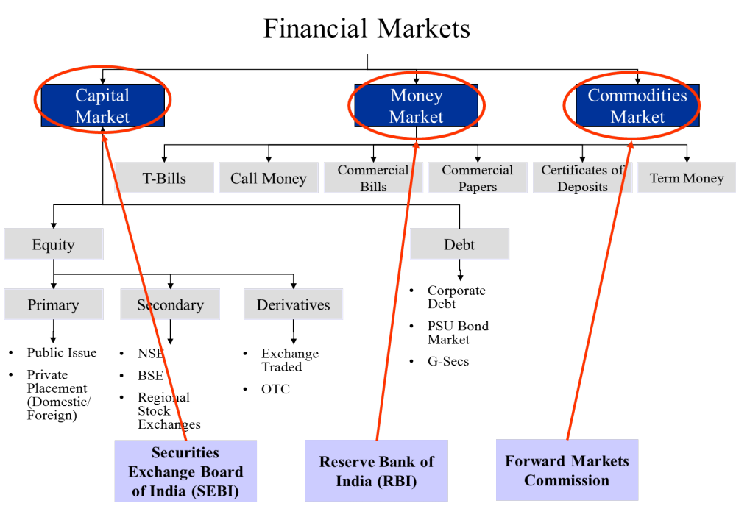

Slide 17
CONCEPT OF ECONOMIC VALUE ADDED
Traditional approaches to measuring ‘Shareholders’ Value Creation used parameters such as earnings capitalisation, market capitalisation and present value of estimated future cash flows.
Extensive equity research has now established that it is not earnings per se, but value which is important.
A new measure called “Economic Value Added” (EVA) is increasingly being applied to understand and evaluate financial performance.
EVA = NOPAT – COCE (Net operating profit after taxes – Cost of Capital Employed)
NOPAT = Profits after depreciation and taxes but before interest costs. NOPAT thus represents the total pool of profits available on an ungeared basis to provide a return to lenders and shareholders;
COCE = Weighted average cost of capital (WACC x Average capital employed)

Slide 18
CONCEPT OF ECONOMIC VALUE ADDED
What does EVA show ?
EVA is residual income after charging the Company for the cost of capital provided by lenders and shareholders. It represents the value added to the shareholders by generating operating profits in excess of the cost of capital employed in the business.
When will EVA increase ?
Operating profits can be made to grow without employing more capital, i.e. greater efficiency.
Additional capital is invested in projects that return more than the cost of obtaining new capital, i.e., profitable growth.
Capital is curtailed in activities that do not cover the cost of capital, i.e., liquidate unproductive capital.
Utility of EVA
(i) EVA represents the value added to the shareholders by generating operating profits over and above the cost of capital employed in the business. Hence it is a measure of financial performance.

Slide 19
CONCEPT OF ECONOMIC VALUE ADDED
Utility of EVA Continued
(ii) EVA is a management tool that discloses the impact of both strategic as well as operational decision of the management. The examples of strategic decisions are: what investment to make, which business to exist, which financial structure is optimal, etc. While operational decision include, whether to make in house or out source, repair or replace equipment or, make short or long production runs, etc.
(iii) EVA can prove as an effective tool for increasing shareholders’ wealth, through integrating EVA framework in four key areas, viz., to measuring business performance, guiding managerial decision-making, aligning managerial incentives with shareholder interests and improving the financial and business literacy throughout the organisation.

Slide 20
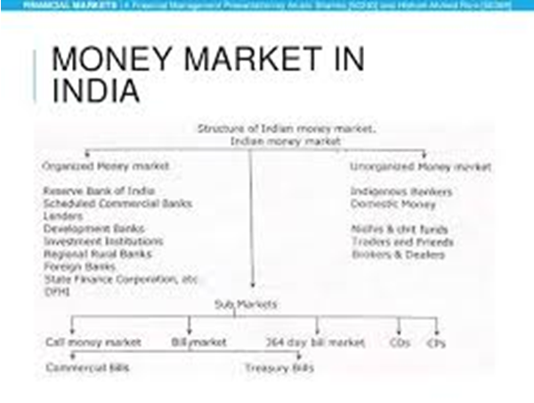

Slide 21
THANK YOU

